Slide 1
Malignant Comments Classification
Report Summary
Submitted by:
SANTOSH H. HULBUTTI
Intern @ Flip Robo Technologies

Slide 2
The Problem Statement
The proliferation of social media enables people to express their opinions widely online. However, at the same time, this has resulted in the emergence of conflict and hate, making online environments uninviting for users. Although researchers have found that hate is a problem across multiple platforms, there is a lack of models for online hate detection.
Online hate, described as abusive language, aggression, cyber bullying, hatefulness and many others has been identified as a major threat on online social media platforms. Social media platforms are the most prominent grounds for such toxic behavior.
Our goal is to build a prototype of online hate and abuse comment classifier which can used to classify hate and offensive comments so that it can be controlled and restricted from spreading hatred and cyberbullying.

Slide 3
Understanding the problem & dataset
Difference between multi-class classification & multi-label classification is that in multi-class problems the classes are mutually exclusive, whereas for multi-label problems each label represents a different classification task, but the tasks are somehow related.
For example, multi-class classification makes the assumption that each sample is assigned to one and only one label: a fruit can be either an apple or a pear but not both at the same time. Whereas, an instance of multi-label classification can be that a comment might be rude, threatening, malignant or all at once.
The data set includes following multiclass:
Malignant: It is the Label column, which includes values 0 and 1, denoting if the comment is malignant or not.
Highly Malignant: It denotes comments that are highly malignant and hurtful.
Rude: It denotes comments that are very rude and offensive.
Threat: It contains indication of the comments that are giving any threat to someone.
Abuse: It is for comments that are abusive in nature.
Loathe: It describes the comments which are hateful and loathing in nature.
ID: It includes unique Ids associated with each comment text given.
Comment text: This column contains the comments extracted from various social media platforms.

Slide 4
Preprocessing Steps
Convert the text to lowercase
Remove the punctuations, digits and special characters
Tokenize the text, filter out the adjectives used in the review and create a new column in data frame
Remove the stop words
Stemming and Lemmatization
Applying Text Vectorization to convert text into numeric

Slide 5
Visualizations
Plots used for Data Visualization:
Distribution plots
Count plots
Bar plots
Word Clouds
Heatmaps

Slide 6
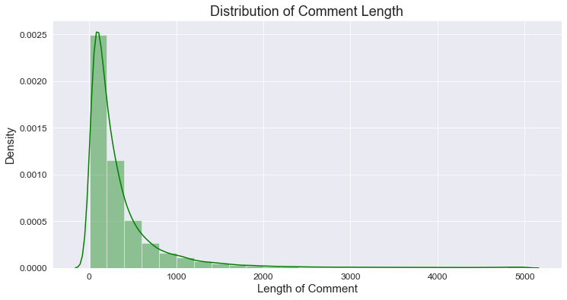
Distribution of Length of comments
From uncleaned data
Most of the comments’ length was less than 1000 words.

Slide 7
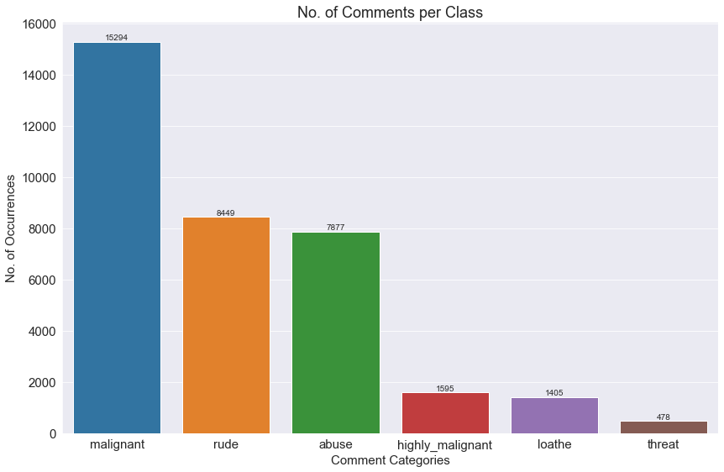
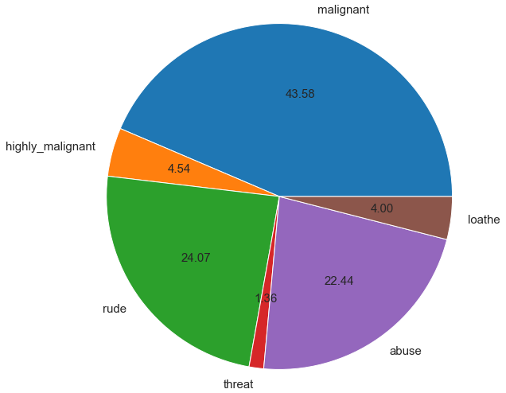
Multiclass Count:
Out of total Negative comments the maximum negative comments come with Malignant(43.6%) in nature followed by rude(24.1%) categories.

Slide 8
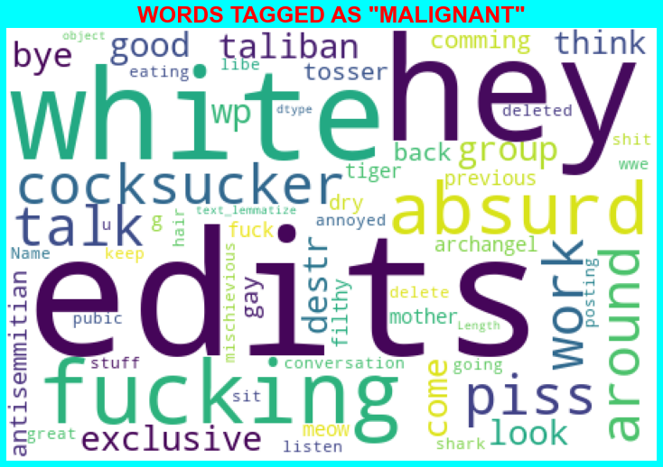
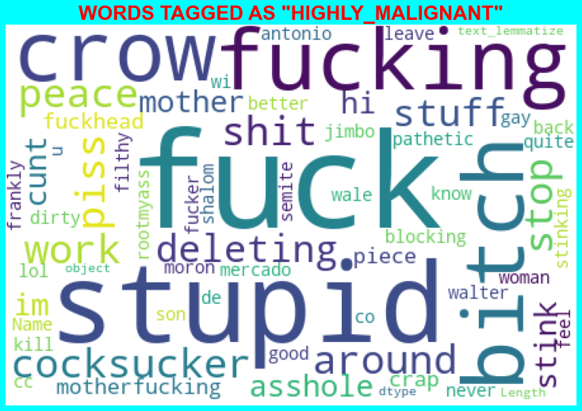
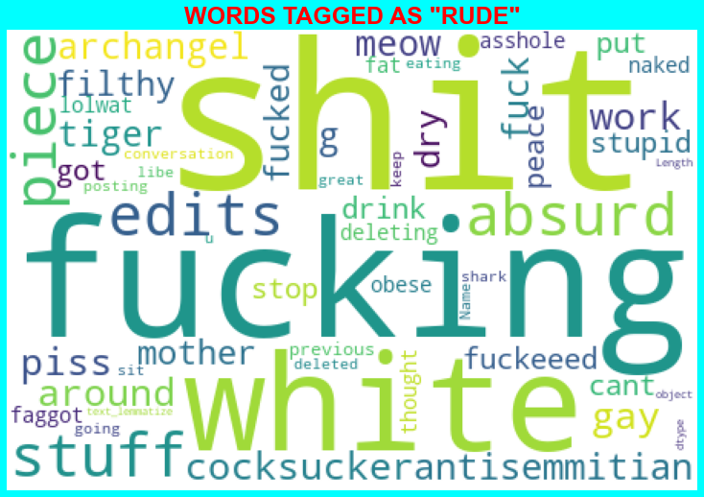
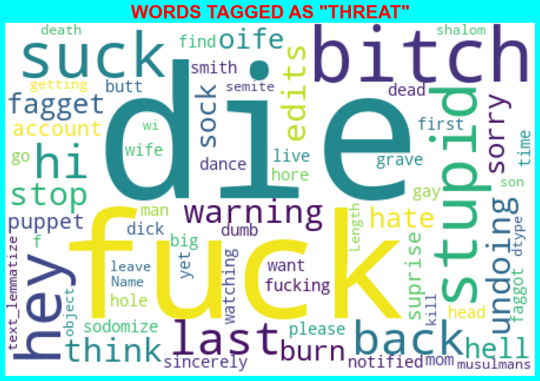
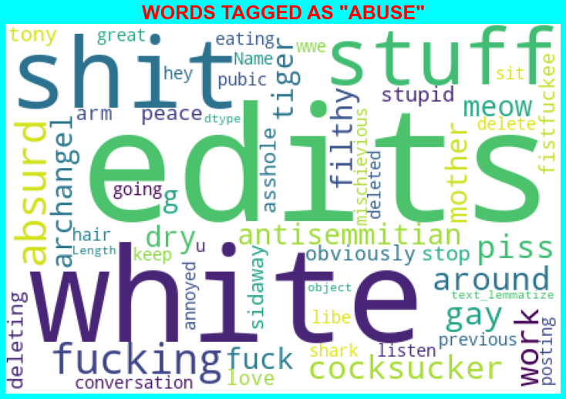
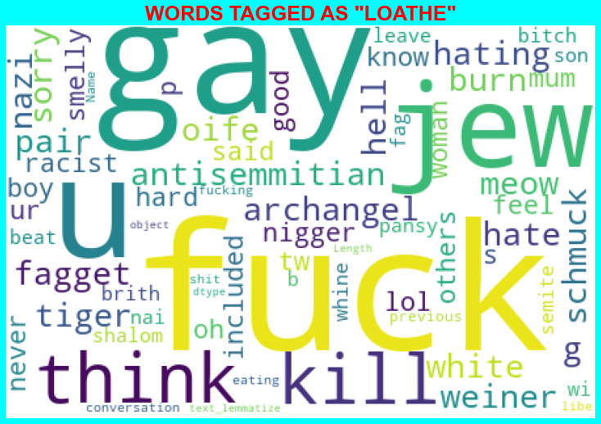
Word Clouds
negative comments include words like edits, hey, die, bitch, suck, white, crow, absurd, Taliban, fuck/fucking, gay, cocksucker, jew, kill, hate, fagget, piss & shit.

Slide 9
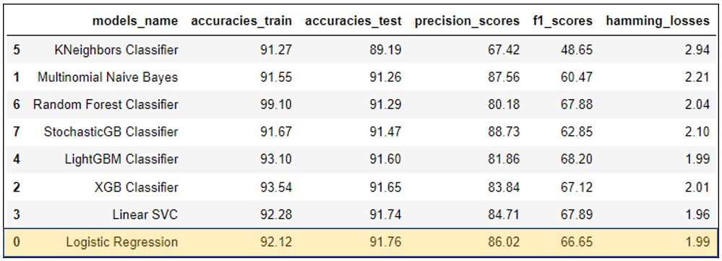
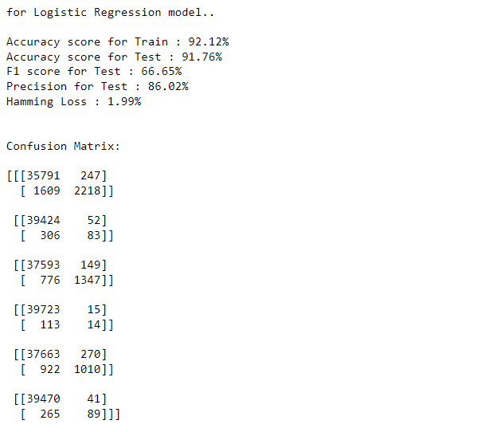
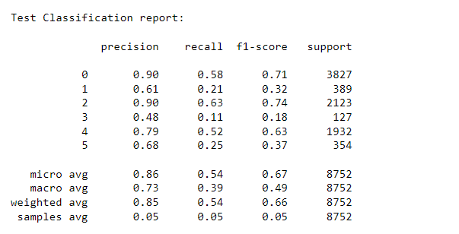
Finalized Model
Model Selection Table
Hyper parameter tuned model
We selected Logistic Regressor for the following reasons:
Maximum ACCURACY with high Precision value.
Minimum hamming loss.

Slide 10
Conclusion
Out of total Negative comments the maximum negative comments come with Malignant in nature followed by rude categories.
Around 90% comments are Good/Neutral in nature while rest 10% comments are Negative in nature.
Very few comments come with threatening nature.
Most of the comments are short with only a few comments longer than 1000 words.
Majority of the comments are of length 500, where maximum length is 5000 and minimum is 5.
From word cloud, it is clear that negative comments include words like edits, hey,die, bitch, suck, white, crow, absurd, Taliban, fuck/fucking, gay, cocksucker, jew, kill, hate, fagget, piss & shit.

